Slide 1
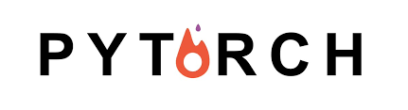
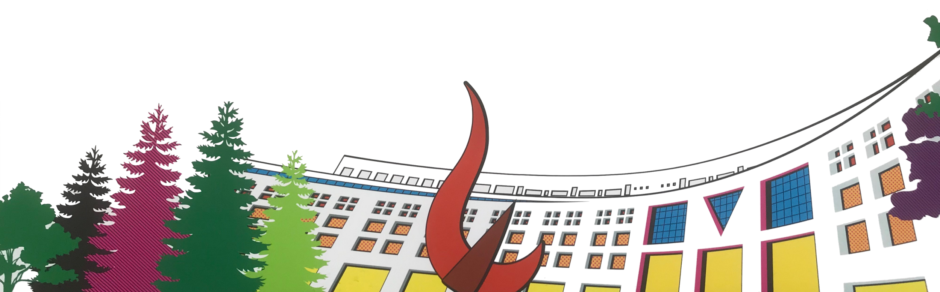

ML/DL for Everyone with
Lecture 12:
NSML, Smartest ML Platform
Sung Kim <hunkim+ml@gmail.com> HKUST
Code: https://github.com/hunkim/PyTorchZeroToAll
Slides: http://bit.ly/PyTorchZeroAll

Slide 2
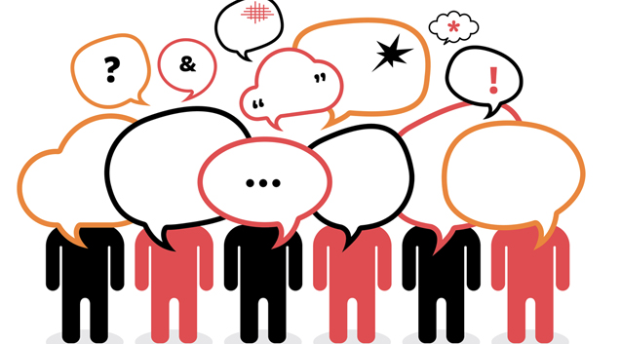
Call for Comments
Please feel free to add comments directly on these slides.
Other slides: http://bit.ly/PyTorchZeroAll
Picture from http://www.tssablog.org/archives/3280

Slide 3
ML/DL for Everyone with
Lecture 12:
NSML, Smartest ML Platform (TBA)
Sung Kim <hunkim+ml@gmail.com> HKUST
Code: https://github.com/hunkim/PyTorchZeroToAll
Slides: http://bit.ly/PyTorchZeroAll

Slide 4
TBA

Slide 5
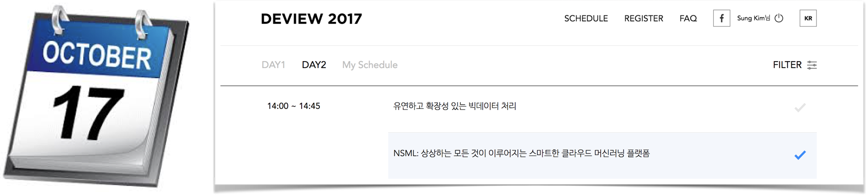
Info session @DEVIEW (in Korean)

Slide 6


Many more
fun networks
• Language Model (RNN-LM)
• Generative Adversarial Network
• Image Captioning (CNN-RNN)
• Deep Convolutional GAN (DCGAN)
• Variational Auto-Encoder
• Neural Style Transfer
• …
https://github.com/yunjey/pytorch-tutorial

Slide 7
Upcoming topics (TBA)
• Wasserstein GAN
• OptNet: Differentiable Optimization as a Layer in Neural Networks
• Paying More Attention to Attention: Improving the Performance of Convolutional Neural Networks via Attention Transfer
• Wide ResNet model in PyTorch
• Task-based End-to-end Model Learning
• An End-to-End Trainable Neural Network for Image-based Sequence Recognition and Its Application to Scene Text Recognition
• Scaling the Scattering Transform: Deep Hybrid Networks
• Adversarial Generator-Encoder Network
• Conditional Similarity Networks
• Multi-style Generative Network for Real-time Transfer
• Image-to-Image Translation with Conditional Adversarial Networks
• Unpaired Image-to-Image Translation using Cycle-Consistent Adversarial Networks
• Inferring and Executing Programs for Visual Reasoning
• On the Effects of Batch and Weight Normalization in Generative Adversarial Networks
• Train longer, generalize better: closing the generalization gap in large batch training of neural networks
• Neural Message Passing for Quantum Chemistry
• DiracNets: Training Very Deep Neural Networks Without Skip-Connections
• Deal or No Deal? End-to-End Learning for Negotiation Dialogues
…
…
…
https://github.com/ritchieng/the-incredible-pytorch

Slide 8
References
http://pytorch.org/
https://github.com/pytorch/examples
https://github.com/ritchieng/the-incredible-pytorch
https://github.com/yunjey/pytorch-tutorial
https://github.com/znxlwm/pytorch-generative-model-collections
https://www.facebook.com/groups/TensorFlowKR/ (in Korean)
https://www.facebook.com/groups/PyTorchKR/ (in Korean)

Slide 9
ML/DL for Everyone with
More lectures TBA
Sung Kim <hunkim+ml@gmail.com> HKUST
Code: https://github.com/hunkim/PyTorchZeroToAll
Slides: http://bit.ly/PyTorchZeroAll

